Slide 1
Introduction to WebAssembly
Ivan Towlson
Fermyon

Slide 2



Slide 3
data types
i32 | i64
f32 | f64

Slide 4
sections
type
func
memory | data | table
import | export

Slide 5
instructions
local.get | local.set | …
i32.load | i32.store | i64.load | …
i32.add | i32.sub | i32.mul | …
loop | if | call | …

Slide 6
standard library
∅

Slide 7

hosts and guests

Slide 8
hosts and guests
(export)

Slide 9
hosts and guests
(import)

Slide 10



hosts and guests

Slide 11
fetch
instantiateStreaming
instance
exports

Slide 12


fetch
instantiateStreaming
instance
exports

Slide 13
imports
fetch
instantiateStreaming
instance
exports

Slide 15


Slide 16
tool chains
C/C++ (Emscripten) | Rust (wasm-pack)
Go | Swift
C# (Blazor) | Java | Kotlin | Python
Haskell | Lua | Ruby | Zig | Grain
… many many more …
https://www.fermyon.com/wasm-languages/webassembly-language-support

Slide 17
small | simple | safe | standard
verifiable
lightweight
portable
sandboxed

Slide 18
imports
fetch
instantiateStreaming
instance
exports

Slide 19
imports
exports

Slide 20

exports

Slide 21




exports

Slide 22

exports

Slide 23


Slide 24
exports

Slide 26

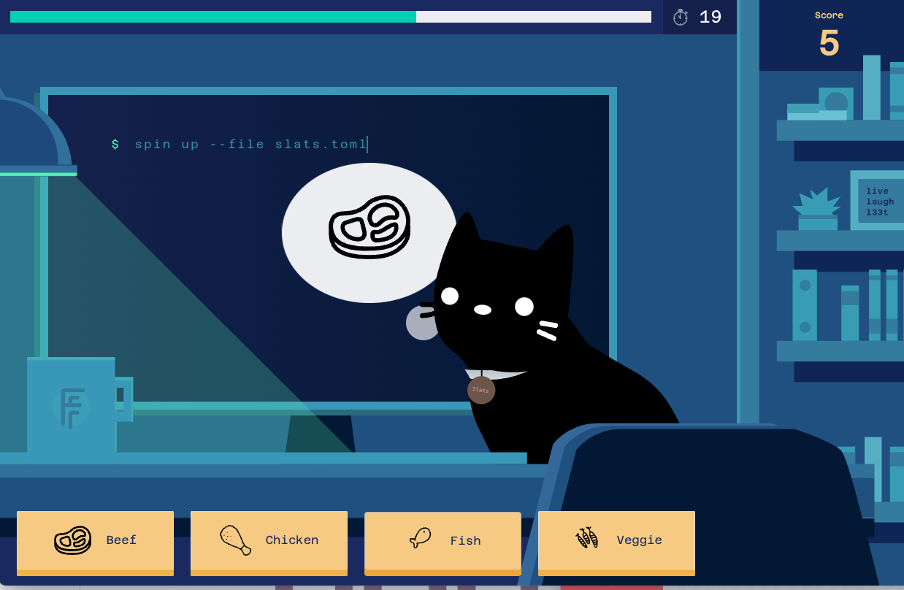
https://www.finickywhiskers.com/
https://github.com/fermyon/finicky-whiskers

Slide 27
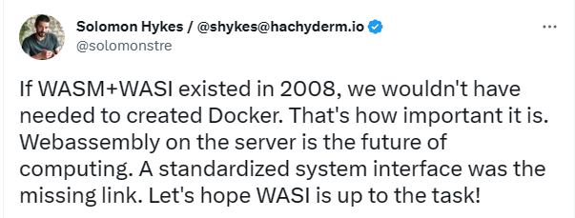

Slide 28
untrusted guest code = cloud computing

Slide 29
Virtual machines
Low density
Minutes to start

Slide 30
Virtual machines
Containers
Low density
Minutes to start
Medium density
Seconds to start

Slide 31
Virtual machines
Containers
Wasm modules
Low density
Minutes to start
Medium density
Seconds to start
High density
Milliseconds to start

Slide 32
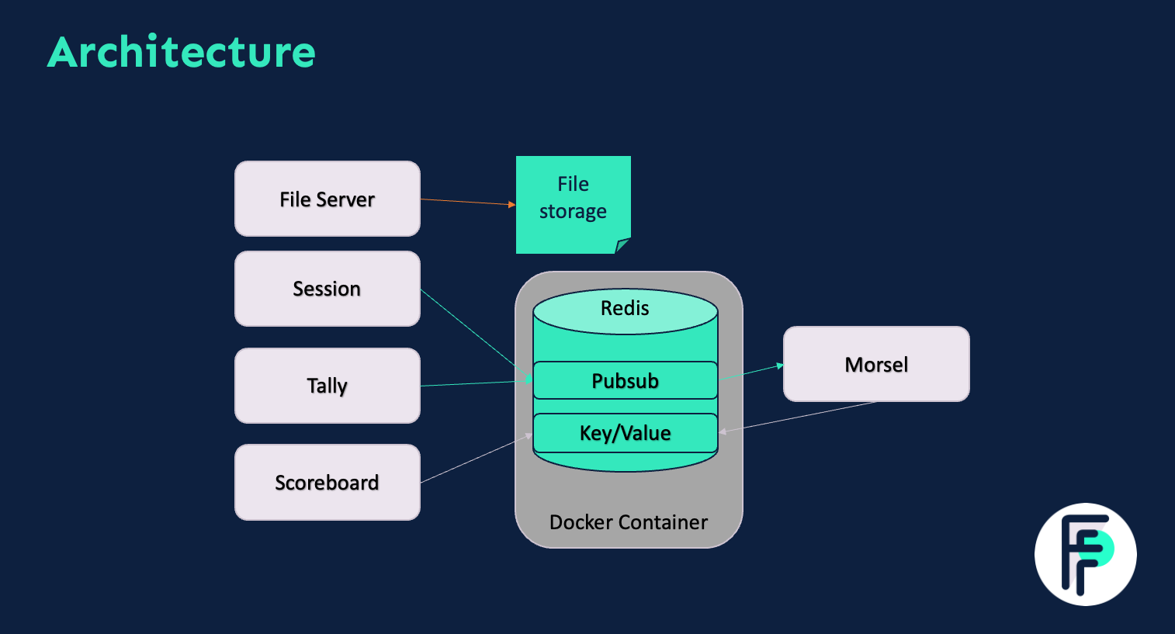
https://www.fermyon.com/blog/finicky-whiskers-part-3-microservices

Slide 33
small | simple | safe | standard
makes Wasm a great bet for the browser

Slide 34
small | simple | safe | standard
makes Wasm a great bet for the cloud

Slide 35
thanks!
https://github.com/itowlson/codecamp23
https://developer.fermyon.com/spin
https://www.finickywhiskers.com
ivan.towlson@fermyon.com | @ppog_penguin@mastodon.nz

